Slide 1
Heaps
2
5
6
9
7
© 2013 Goodrich, Tamassia, Goldwasser
Heaps
Notes:
Heaps

Slide 2
Recall Priority Queue ADT
A priority queue stores a collection of items
Each item is a pair
(key, value)
Main methods of the Priority Queue ADT
  add(k, x)
  inserts an item with key k and value x
  remove_min()
  removes and returns the item with smallest key
Additional methods
  min()
  returns, but does not remove, an item with smallest key
  len(), is_empty()
Applications:
  Standby flyers
  Auctions
  Stock market
© 2013 Goodrich, Tamassia, Goldwasser
Heaps

Slide 3

Recall PQ Sorting
We use a priority queue
  Insert the elements with a series of add operations
  Remove the elements in sorted order with a series of remove_min operations
The running time depends on the priority queue implementation:
  Unsorted sequence gives selection-sort: O(n²) time
  Sorted sequence gives insertion-sort: O(n²) time
Can we do better?
Algorithm PQ-Sort(S, C)
  Input sequence S, comparator C for the elements of S
  Output sequence S sorted in increasing order according to C
  P ← priority queue with comparator C
  while ¬S.is_empty ()
  e ← S.remove (S. first ())
    P.add(e, e)
  while ¬P.is_empty()
  e ← P.remove_min().key()
    S.add_last(e)
© 2013 Goodrich, Tamassia, Goldwasser
Heaps

Slide 4
Heaps
A heap is a binary tree storing keys at its nodes and satisfying the following properties:
Heap-Order: for every internal node v other than the root,
key(v) ≥ key(parent(v))
Complete Binary Tree: let h be the height of the heap
  for i = 0, … , h − 1, there are 2^{i} nodes of depth i
  at depth h − 1, the internal nodes are to the left of the external nodes
The last node of a heap is the rightmost node of maximum depth
2
5
6
9
7
last node
© 2013 Goodrich, Tamassia, Goldwasser
Heaps
Notes:
Heaps

Slide 5
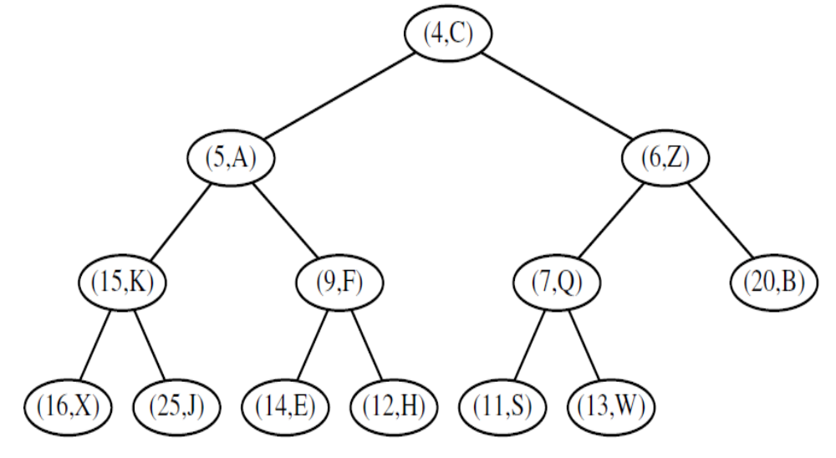
Example of a heap storing Key-Value pairs
© 2013 Goodrich, Tamassia, Goldwasser
Heaps

Slide 6

Height of a Heap
Theorem: A heap storing n keys has height O(log n)
Proof: (we apply the complete binary tree property)
  Let h be the height of a heap storing n keys
  Since there are 2^{i} keys at depth i = 0, … , h − 1 and at least one key at depth h, we have n ≥ 1 + 2 + 4 + … + 2^{h−1} + 1
  Thus, n ≥ 2^{h} , i.e., h ≤ log n
depth
keys
0
1
1
2
h−1
2^{h−1}
h
1
© 2013 Goodrich, Tamassia, Goldwasser
Heaps
Notes:
Heaps

Slide 7
Heaps and Priority Queues
We can use a heap to implement a priority queue
We store a (key, element) item at each internal node
We keep track of the position of the last node
(2, Sue)
(5, Pat)
(6, Mark)
(9, Jeff)
(7, Anna)
© 2013 Goodrich, Tamassia, Goldwasser
Heaps

Slide 8
Insertion into a Heap
Method add of the priority queue ADT corresponds to the insertion of a key k to the heap
The insertion algorithm consists of three steps
  Find the insertion node z (the new last node)
  Store k at z
  Restore the heap-order property (discussed next)
2
5
z
6
9
7
insertion node
2
5
6
z
9
7
1
© 2013 Goodrich, Tamassia, Goldwasser
Heaps

Slide 9
Upheap
After the insertion of a new key k, the heap-order property may be violated
Algorithm upheap restores the heap-order property by swapping k along an upward path from the insertion node
Upheap terminates when the key k reaches the root or a node whose parent has a key smaller than or equal to k
Since a heap has height O(log n), upheap runs in O(log n) time
2
1
5
1
5
2
z
z
9
7
6
9
7
6
© 2013 Goodrich, Tamassia, Goldwasser
Heaps

Slide 10
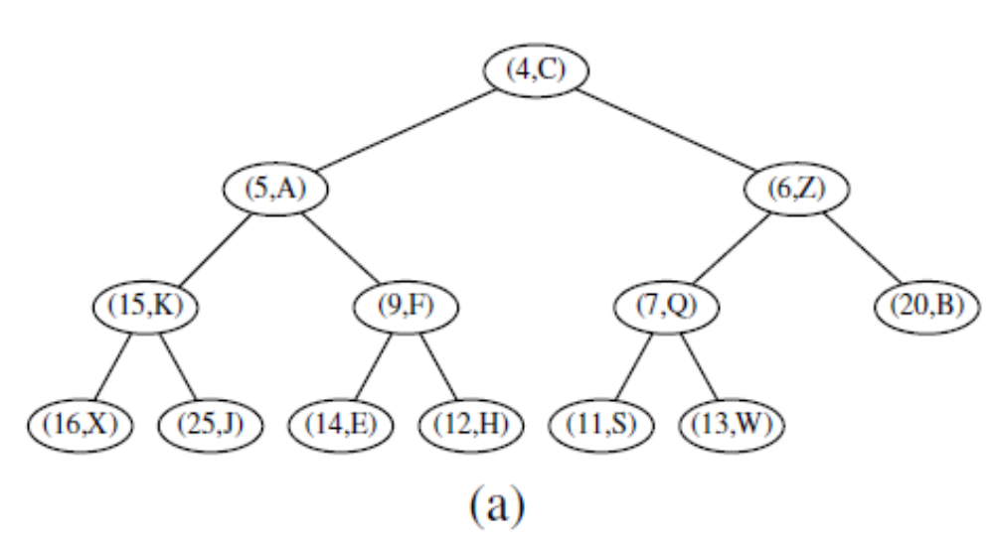
Let’s Insert (2,T)
© 2013 Goodrich, Tamassia, Goldwasser
Heaps
Notes:
Heaps

Slide 11
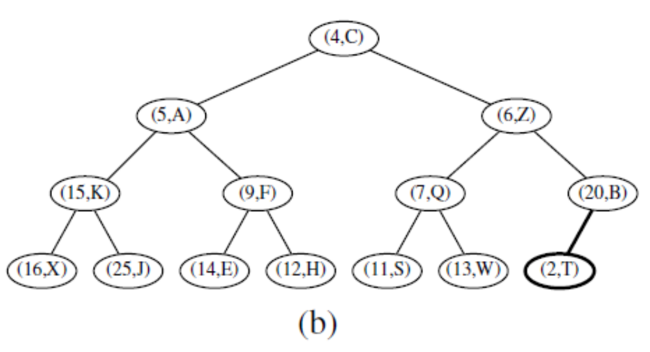
Let’s Insert (2,T)
© 2013 Goodrich, Tamassia, Goldwasser
Heaps
Notes:
Heaps

Slide 12
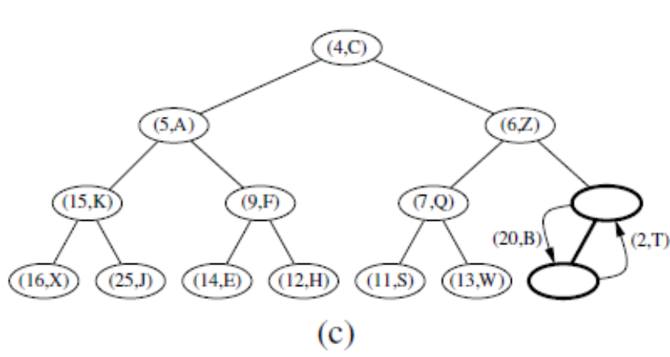
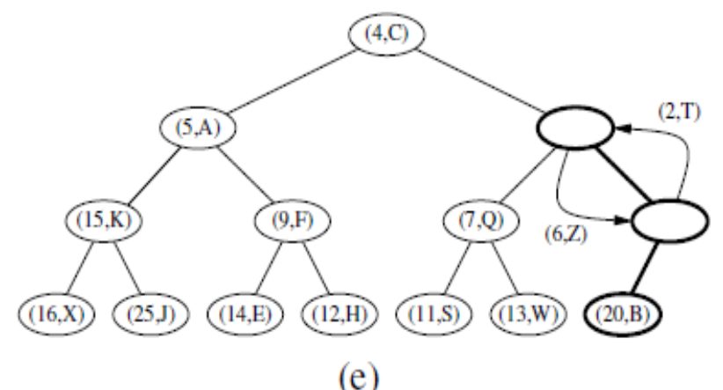
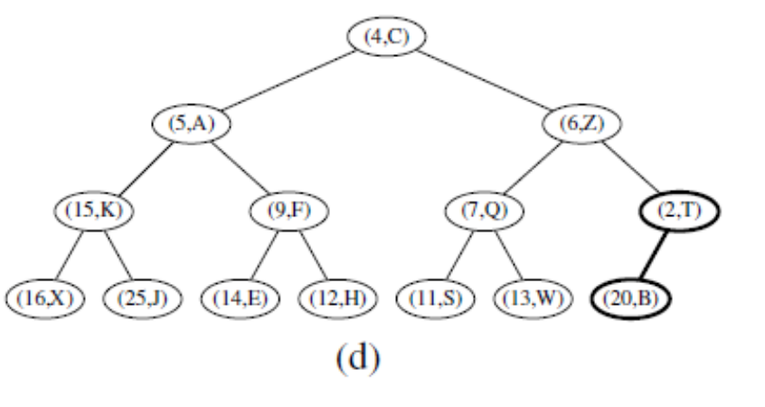
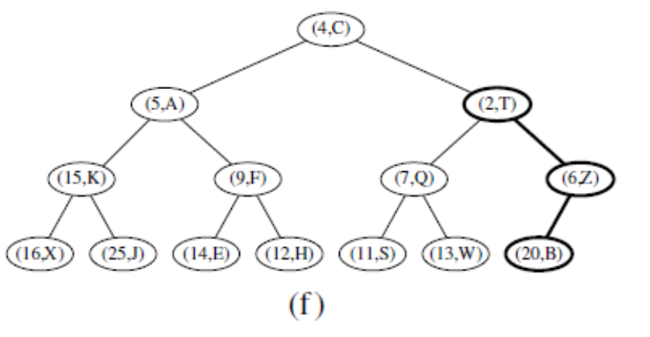
Let’s Insert (2,T)
© 2013 Goodrich, Tamassia, Goldwasser
Heaps
Notes:
Heaps

Slide 13
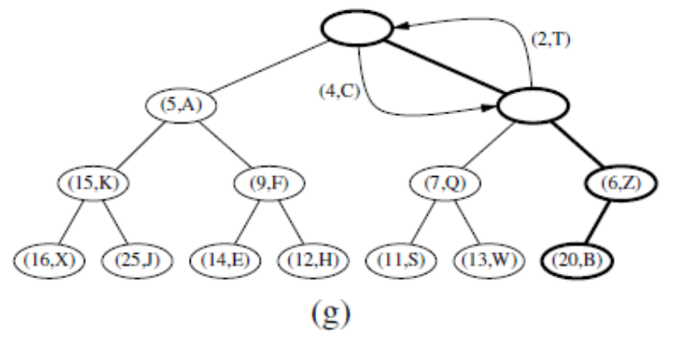
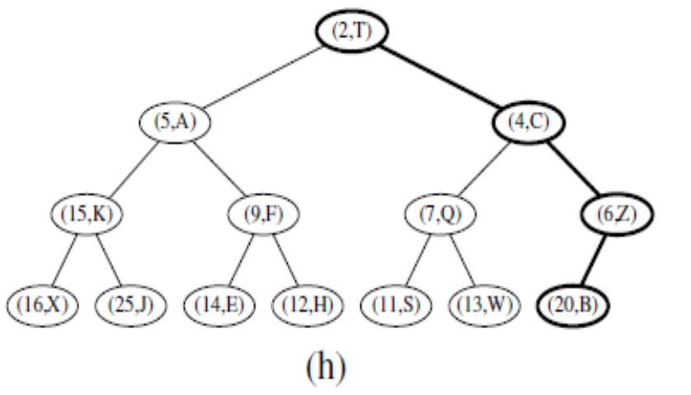
Let’s Insert (2,T)
© 2013 Goodrich, Tamassia, Goldwasser
Heaps

Slide 14
Removal from a Heap
Method remove_min of the priority queue ADT corresponds to the removal of the root key from the heap
The removal algorithm consists of three steps
  Replace the root key with the key of the last node w
  Remove w
  Restore the heap-order property (discussed next)
2
5
6
w
9
7
last node
7
5
w
6
9
new last node
© 2013 Goodrich, Tamassia, Goldwasser
Heaps

Slide 15
Downheap
After replacing the root key with the key k of the last node, the heap-order property may be violated
Algorithm downheap restores the heap-order property by swapping key k along a downward path from the root
Upheap terminates when key k reaches a leaf or a node whose children have keys greater than or equal to k
Since a heap has height O(log n), downheap runs in O(log n) time
7
5
5
w
6
7
w
6
9
9
© 2013 Goodrich, Tamassia, Goldwasser
Heaps

Slide 16
Let’s Remove_min (4,C)
© 2013 Goodrich, Tamassia, Goldwasser
Heaps
Notes:
Heaps

Slide 17
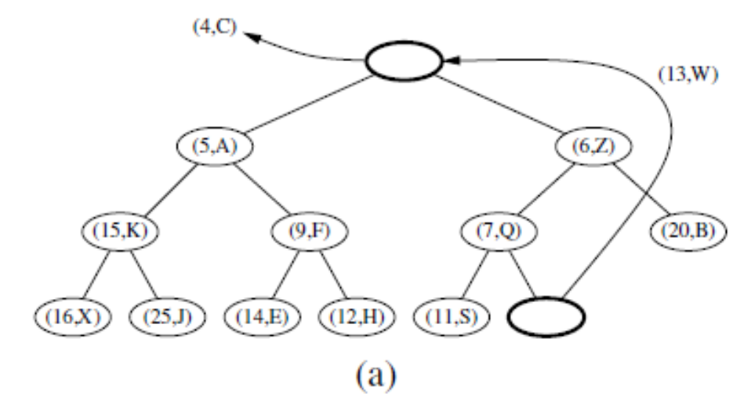
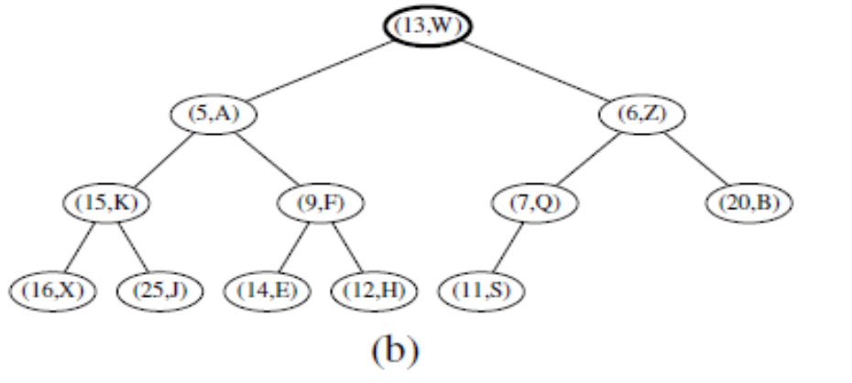
Let’s Remove_min (4,C)
© 2013 Goodrich, Tamassia, Goldwasser
Heaps
Notes:
Heaps

Slide 18
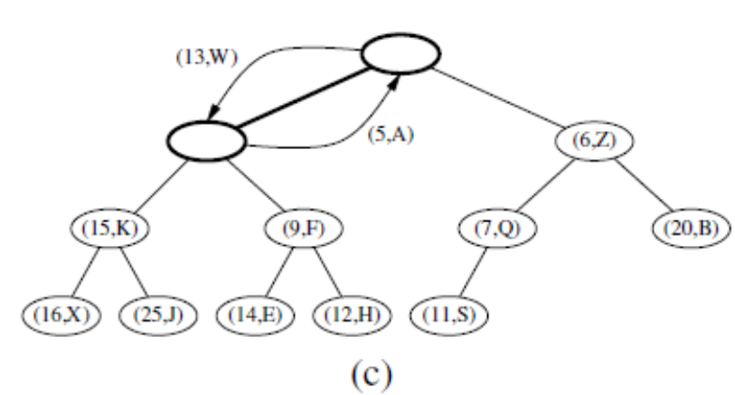
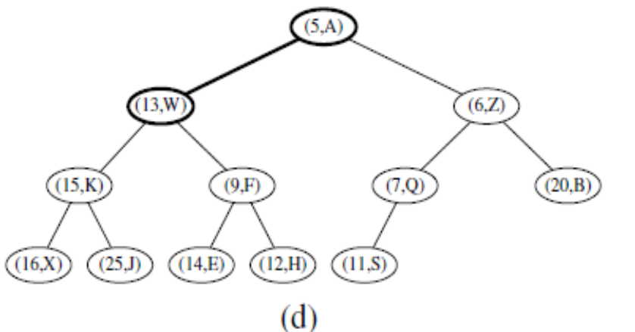
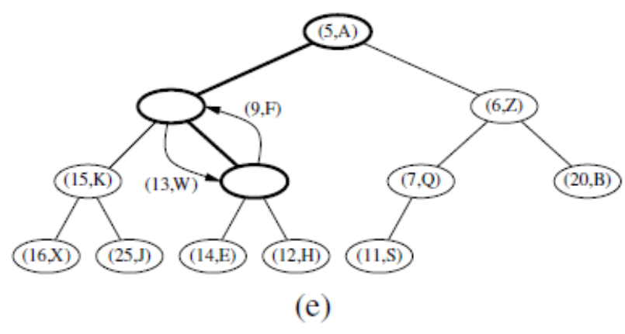
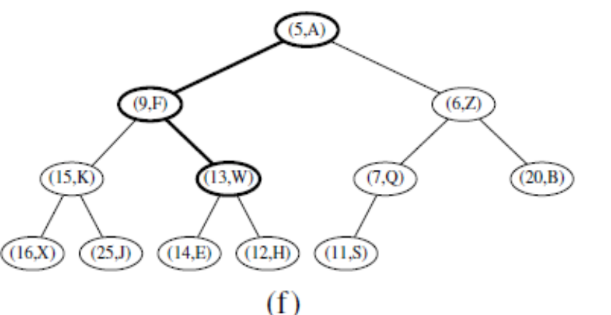
Let’s Remove_min (4,C)
© 2013 Goodrich, Tamassia, Goldwasser
Heaps
Notes:
Heaps

Slide 19
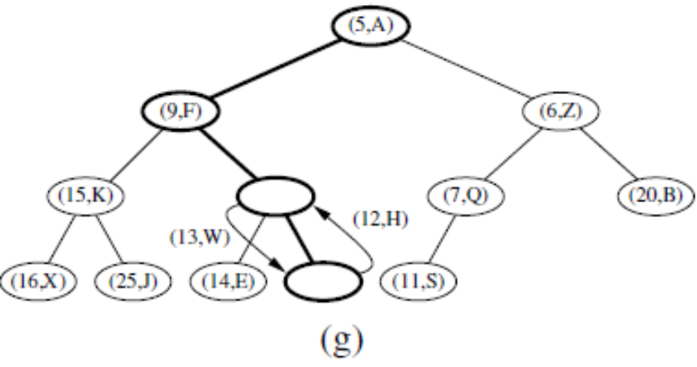
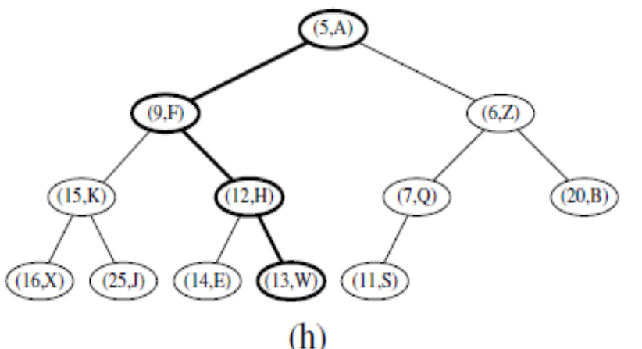
Let’s Remove_min (4,C)
© 2013 Goodrich, Tamassia, Goldwasser
Heaps

Slide 20

Heap-Sort
Consider a priority queue with n items implemented by means of a heap
  the space used is O(n)
  methods add and remove_min take O(log n) time
  methods len, is_empty, and min take time O(1) time
Using a heap-based priority queue, we can sort a sequence of n elements in O(n log n) time
The resulting algorithm is called heap-sort
Heap-sort is much faster than quadratic sorting algorithms, such as insertion-sort and selection-sort
© 2013 Goodrich, Tamassia, Goldwasser
Heaps

Slide 21
Array-based Heap Implementation
We can represent a heap with n keys by means of an array of length n
For the node at rank i
  the left child is at rank 2i + 1
  the right child is at rank 2i + 2
Links between nodes are not explicitly stored
Operation add corresponds to inserting at rank n + 1
Operation remove_min corresponds to removing at rank n
Yields in-place heap-sort
2
5
6
9
7
2
5
6
9
7
0
1
2
3
4
© 2013 Goodrich, Tamassia, Goldwasser
Heaps

Slide 22
Array based Implementation of a heap
(4,c) | (5,A) | (6,Z) | (15,K) | (9,F) | (7,Q) | (20,B) | (16,X) | (25,J) | (14,E) | (12,H) | (11,S) | (13,W)
0 | 1 | 2 | 3 | 4 | 5 | 6 | 7 | 8 | 9 | 10 | 11 | 12
© 2013 Goodrich, Tamassia, Goldwasser
Heaps
Notes:
Heaps

Slide 23
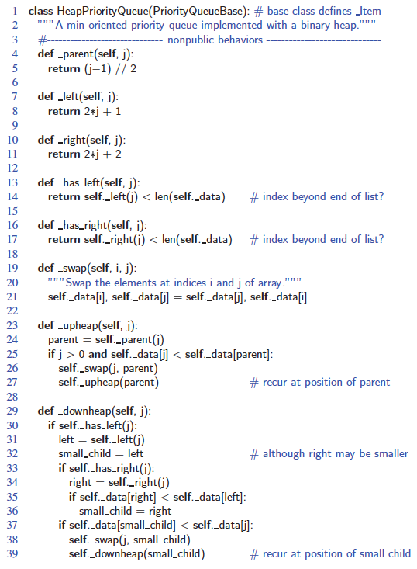
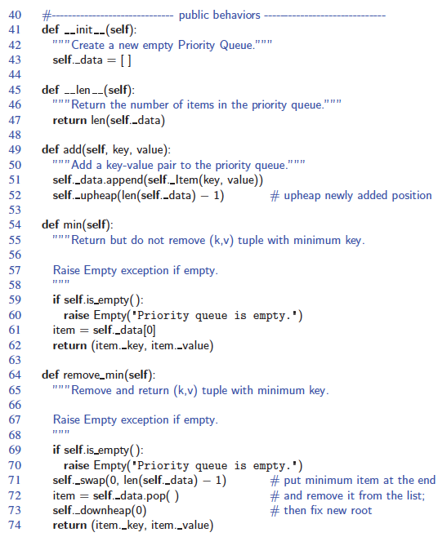
Python Heap Implementation
© 2013 Goodrich, Tamassia, Goldwasser
Heaps

Slide 24
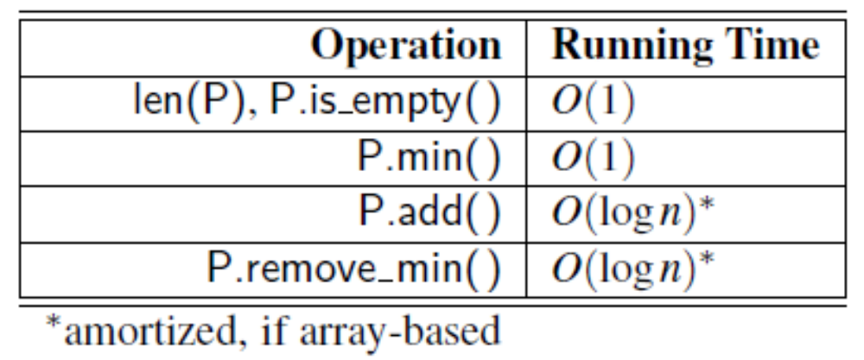
Analysis of a Heap-Based Priority Queue
© 2013 Goodrich, Tamassia, Goldwasser
Heaps
Notes:
Heaps

Slide 25
Merging Two Heaps
We are given two two heaps and a key k
We create a new heap with the root node storing k and with the two heaps as subtrees
We perform downheap to restore the heap-order property
3
2
8
5
4
6
7
3
2
8
5
4
6
2
3
4
8
5
7
6
© 2013 Goodrich, Tamassia, Goldwasser
Heaps

Slide 26

Bottom-up Heap Construction
We can construct a heap storing n given keys in using a bottom-up construction with log n phases
In phase i, pairs of heaps with 2^{i} −1 keys are merged into heaps with 2^{i+1}−1 keys
2^{i} −1
2^{i} −1
2^{i+1}−1
© 2013 Goodrich, Tamassia, Goldwasser
Heaps
Notes:
Heaps

Slide 27
Example
16
15
4
12
6
7
23
20
25
5
11
27
16
15
4
12
6
7
23
20
© 2013 Goodrich, Tamassia, Goldwasser
Heaps

Slide 28
Example (contd.)
25
5
11
27
16
15
4
12
6
9
23
20
15
4
6
23
16
25
5
12
11
9
27
20
© 2013 Goodrich, Tamassia, Goldwasser
Heaps

Slide 29
Example (contd.)
7
8
15
4
6
23
16
25
5
12
11
9
27
20
4
6
15
5
8
23
16
25
7
12
11
9
27
20
© 2013 Goodrich, Tamassia, Goldwasser
Heaps

Slide 30
Example (end)
10
4
6
15
5
8
23
16
25
7
12
11
9
27
20
4
5
6
15
7
8
23
16
25
10
12
11
9
27
20
© 2013 Goodrich, Tamassia, Goldwasser
Heaps

Slide 31
Analysis of Heap Construction
We visualize the worst-case time of a downheap with a proxy path that goes first right and then repeatedly goes left until the bottom of the heap (this path may differ from the actual downheap path)
Since each node is traversed by at most two proxy paths, the total number of nodes of the proxy paths is O(n)
Thus, bottom-up heap construction runs in O(n) time
Bottom-up heap construction is faster than n successive insertions and speeds up the first phase of heap-sort
© 2013 Goodrich, Tamassia, Goldwasser
Heaps
Notes:
Heaps

